Slide 1
CSC 648-848 SECTION 04 TEAM 01
Team Members:
Hruthika - Team Lead
Carlos - FE Lead
Hansley - BE Lead
Iza - Scrum Master
Christian
Tay
Malavya

Slide 2
MEET OUR TEAM
Hruthika
Carlos
Hansley
Iza
Team Lead
FE Lead
BE Lead
Scrum Master
Christian
Tay
Malavya

Slide 3
Keep up
Keep up with your daily activities, finances
and stress​

Slide 4
CONTENTS
1
Introduction
Goal
Main Features - Description
Market Size​ and Customers
Best Team Practices

Slide 5
Ultimate target ?
Money……
Results in?
Stress……
Forgetfulness…….
Other health issues that follow……

Slide 6
Our goal
Provide a single stop solution through our app.
A simplified user interface (SUI) that removes unimportant
elements and reduces them to simpler self explanatory
icons and names.

Slide 7



MAIN FEATURES
NOTEPAD
EXPENSE TRACKER
RELAXER

Slide 8
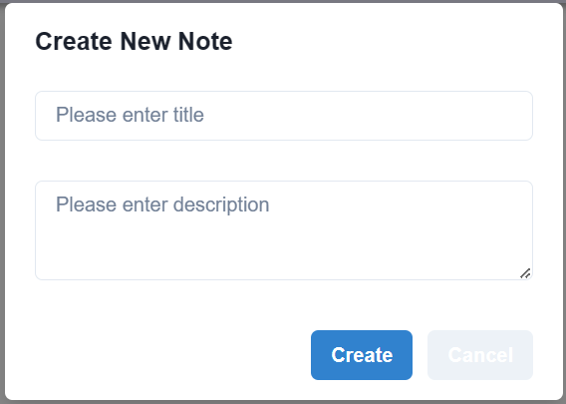
Notepad
Take notes anytime anywhere with just a click
Keep a track of activities
Create new notes
Update existing notes
Delete notes

Slide 9
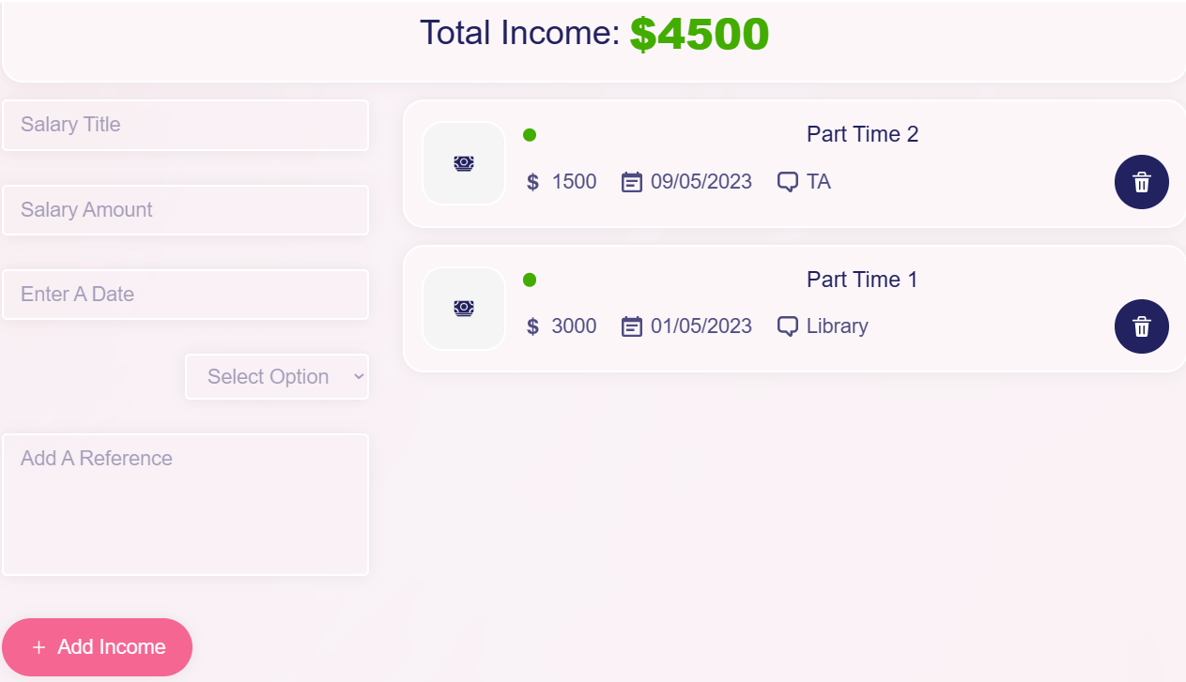
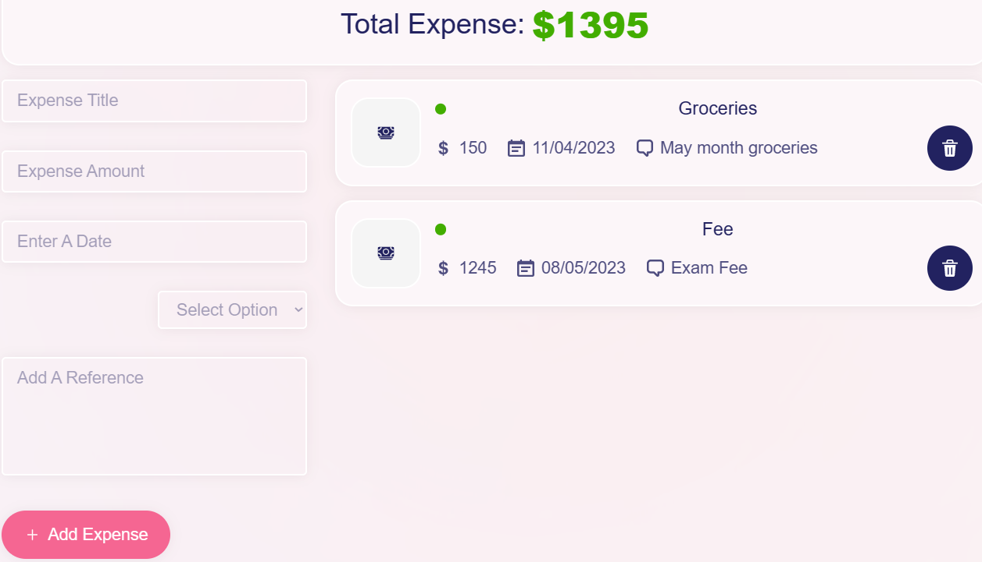
EXPENSE TRACKER
Add income and track income history
Add expense and track expense history

Slide 10
RELAXER
Has a breather feature
Has meditation instructions
Muscle relaxation exercises
Relaxing music

Slide 11
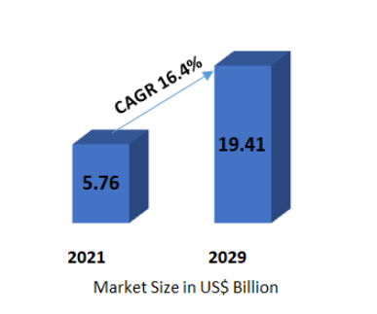
Notes app - market
Few Hundred thousands ……?
Note Taking App Market was valued at US$ 5.76 Bn. in 2021. Global Note Taking App Market size is estimated to grow at a CAGR of 16.4% from 2022 - 2029. [MMR report]
Millions ……….. ?

Slide 12
Our customers
features USAGE

Slide 13
Team Activities
Expertise
Leads
LEARNING PATH
Sub team division
Knowledge sharing
Collect data in each members expertise and experience
Decide FE , BE leads
GIT master
Scrum Master
Come up with a study plan
Divided team into 4 sub teams
3 for feature dev
- 1 for R&D
Seminars from members on their areas of expertise

Slide 14
Team best practices
DEVELOPMENT PRACTICES
DEVELOPMENT PRACTICES
TEAM BUILDING
Strict implementation of our coding style standards – (includes manual review too)
Freedom to individuals for development
Regular team discussions for progress monitoring and backlog tracking
Separate research group
Strong knowledge on their respective technologies
Leads always ready to guide the members and take feedback
Members had internal meetings
Strategies ready in case of any future discrepancies
Strict implementation of our coding style standards – (includes manual review too)
Freedom to individuals for development
Regular team discussions for progress monitoring and backlog tracking
Separate research group
No internal conflicts in the team throughout the development.

Slide 15
FE Team
Notepad
Flexibility and Adaptability
Even after a drastic change in both feature
list and development strategy, the team
quickly got back on track
To Do List
BE Team
Realxer
Notepad
FE + BE
Expense Tracker
FE + BE
Realxer
FE + BE

Slide 16
THANK YOU

